Slide 1

VLSI MINI PROJECT
Digital Stopwatch with Lap Monitoring Using Verilog HDL
FPGA
Presented by
513424106012
513424106024
513424106305

Slide 2




Problem Overview and Proposed Solution
The Problem
Proposed Solution
Timing events needs precise, glitch-free counting
A single time display loses intermediate readings
Software timers lack hardware-level determinism
Stopwatch described in Verilog HDL
Implemented on a Cyclone II FPGA
START / STOP / RESET / LAP controls; lap is captured while the main timer keeps running
Why Lap Monitoring?
Objectives and Expected Outcome
Records split times of repeated events (laps, experiments)
Needs no pause, so total time stays accurate
Good demo of FSM, counters, registers and display driving
Design and verify the stopwatch in ModelSim
Synthesize and download it with Quartus II
Outcome: stopwatch operation with LED status; numerical display depends on compatible display hardware

Slide 3
Functional Output
START
LAP
STOP
LAP
001
010
011
100
101
110
111
111
111
000
001
001
010
011
100
0
40
80
120
160
200
240
280
320
360
400
440
480
520
560
timer_out[2:0] per 40 ns step (ns) from the ModelSim run; dark cells are where a control pulse starts
Control | Observed at | Observed output
START | pulse at 40 ns | timer_out counts up one step per 40 ns: 001 to 111
LAP | pulses at 200 ns and 440 ns | Counting is not interrupted; timer_out keeps updating
STOP | pulse at 360 ns | timer_out reads 000 at 360 ns and updates again from 400 ns
RESET | held low in this run | Not asserted in this capture
Output observed in ModelSim simulation of the project design (clk, start, stop, reset, lap, timer_out[2:0]).

Slide 4
Internal States and Output Indication
IDLE
time = 0
START
RUN
counting
STOP
STOP
frozen
RESET returns any state to IDLE.
LAP in RUN copies the count into the lap register; state stays RUN.
START
LED | Meaning | Internal state
LED_RUN | Stopwatch counting | RUN
LED_STOP | Stopwatch paused | STOP
LED_LAP | Lap time captured/shown | LAP flag set

Slide 5
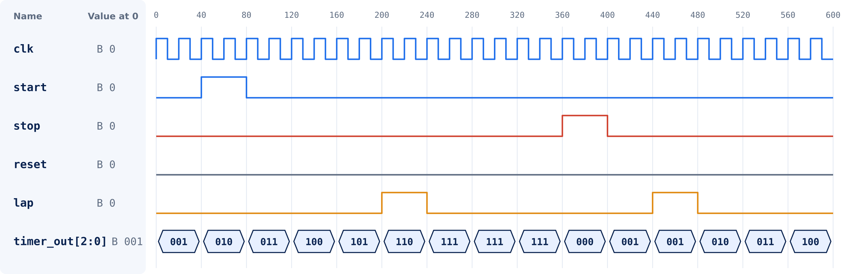
Simulation Using ModelSim
Test 1: Start and count
Test 2: Stop
Test 3: Lap
START at 40 ns; timer_out steps 001 to 110 by 240 ns.
STOP at 360 ns; timer_out reads 000, updates again from 400 ns.
LAP at 200 and 440 ns; timer_out keeps updating. reset stays 0 here.

Slide 6
RTL Architecture
Push buttons
START/STOP/
LAP/RESET
Debounce /
Control FSM
Status LEDs
Stopwatch
counter
(min:sec:centi)
Display driver
(7-seg decode)
Display
LEDs
50 MHz
clock
Clock divider
(1 Hz / 100 Hz tick)
Lap register
start/stop/reset | tick enable | lap capture | count and lap values to display

Slide 7


FPGA Implementation
Signal Name | Direction | Function
clk | Input | FPGA clock
start | Input | Start button
stop | Input | Stop button
reset | Input | Reset button
lap | Input | Lap button
timer_out[0] | Output | LED 0
timer_out[1] | Output | LED 1
timer_out[2] | Output | LED 2
Design flow
Verilog code compiled in Quartus II
Pins assigned in Pin Planner
8 I/O pins used: 5 inputs, 3 outputs
Design targets the Cyclone II FPGA
Connections
Assigned board inputs control start, stop, reset and lap; the verified FPGA clock drives clk; timer_out[2:0] drives three assigned LEDs.

Slide 8

Resource Analysis
Quartus II Flow Summary
Resource | Used
Logic Elements (LEs) | To be filled from Quartus report
Registers | To be filled from Quartus report
Memory bits / blocks | To be filled from Quartus report
I/O pins | 8 (5 inputs, 3 outputs)
Where to find it
Quartus II: Compilation Report > Flow Summary. Enter the values from your actual compilation.
I/O pins used: 8
clk
start
stop
reset
lap
timer_out[0]
timer_out[1]
timer_out[2]
Blue = inputs (clk, buttons)
Navy = outputs (LED 0 to LED 2)

Slide 9


Timing Analysis
Parameter | Tool-reported (Quartus) | Expected / reference
Maximum frequency (Fmax) | To be filled from Quartus report | Simulation clock: 20 ns period (50 MHz)
Critical path | To be filled from Quartus report | Longest register-to-register path
Setup slack | To be filled from Quartus report | Must be 0 ns or more
Timing result | To be filled from Quartus report | Met when slack is not negative
How to read the report
Interpretation
Fmax = 1 / critical path delay
Slack = required time - arrival time
Positive slack means timing is met
The 20 ns clock in the ModelSim run is a simulation setting, not a Quartus result. Fmax is compared with it once the Timing Analyzer value is filled in.

Slide 10


Conclusion
Stopwatch with START, STOP, RESET and LAP designed in Verilog HDL
Future enhancements
Verified with ModelSim test cases (count, stop/resume, reset/lap)
Multiple lap memory
VGA display output
Count-down timer mode
Modular RTL: clock divider, FSM, counter, lap register, display driver
Targets Cyclone II; LEDs indicate states, with numerical display only if compatible hardware is available
Resource use and timing must be taken from the actual Quartus II reports
Thank You

